Slide 1



LIFELINK HUB HEALTHCARE APP
Created by: GROUP B2

Slide 2

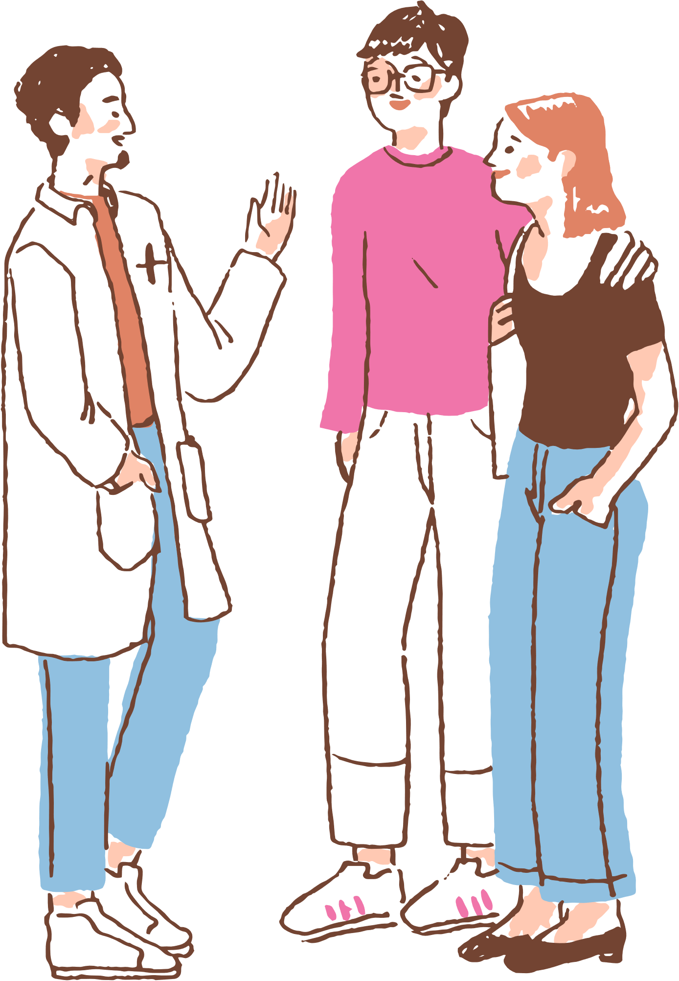

AGENDA
Introduction
Target Audience
Features
Designing and Developing
Challenges

Slide 3
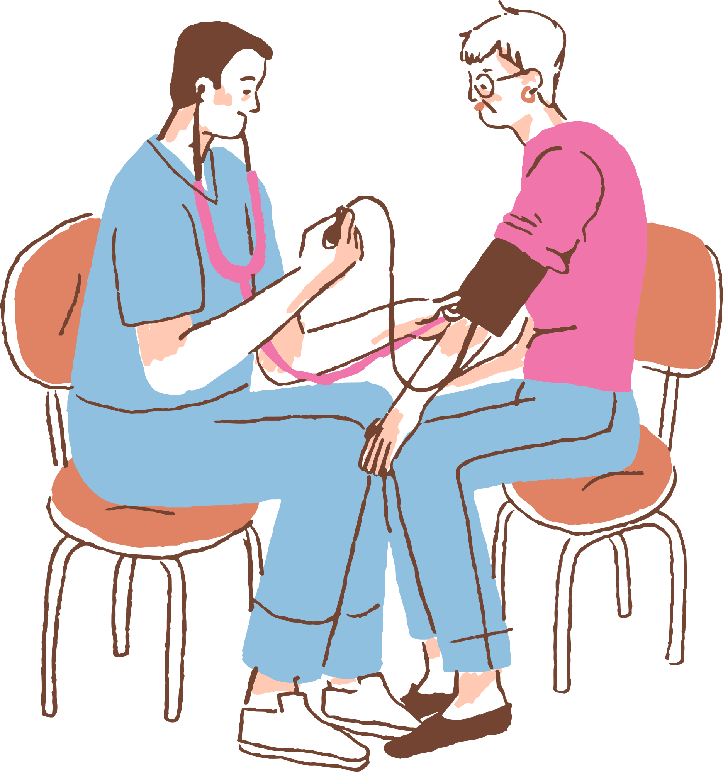
INTRODUCTION
LifeLink Hub is a Healthcare app that offers many healthcare facilities.
Issue - The difficulty for an individual to take care of their own health. Frequently failing to monitor medication consumption, making appointments, not being aware with the patient's condition, and, above all, not receiving appropriate emotional support.

Slide 4


TARGET AUDIENCE
Patients and caregivers,
Mental Health Seekers,
Families
Pharmacy and Lab Users
Elderly people
Healthcare Professionals
General Users

Slide 5

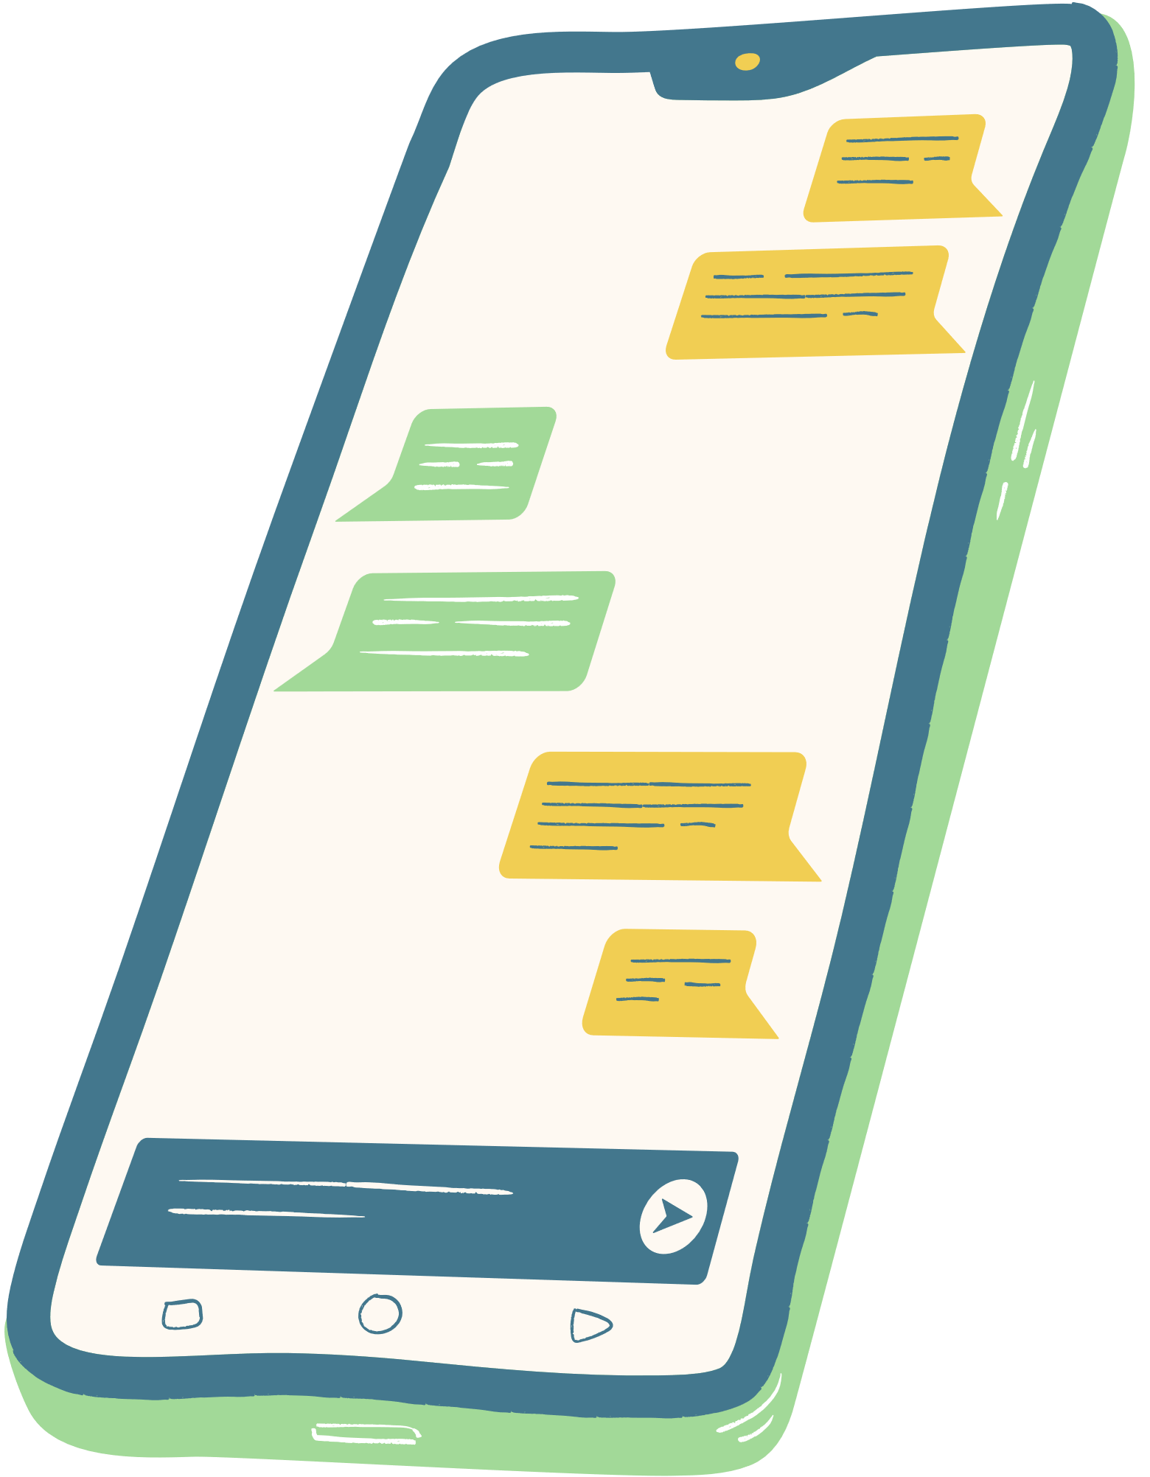

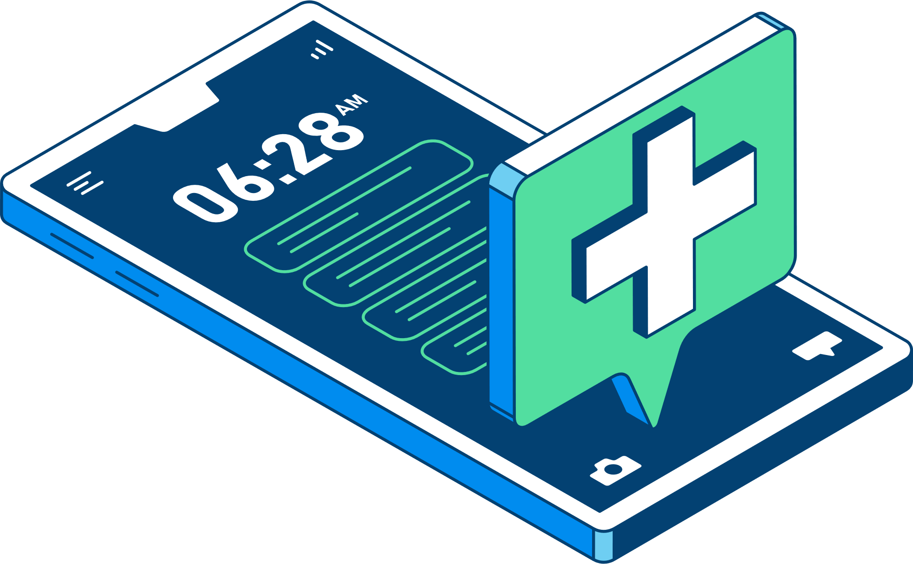
FEAUTURES
E-channeling
Mind Mate - AI chatbot
Talk to Doctor Now
Emergency
Medication Manager
Medication Reminder
Medication Resources

Slide 6
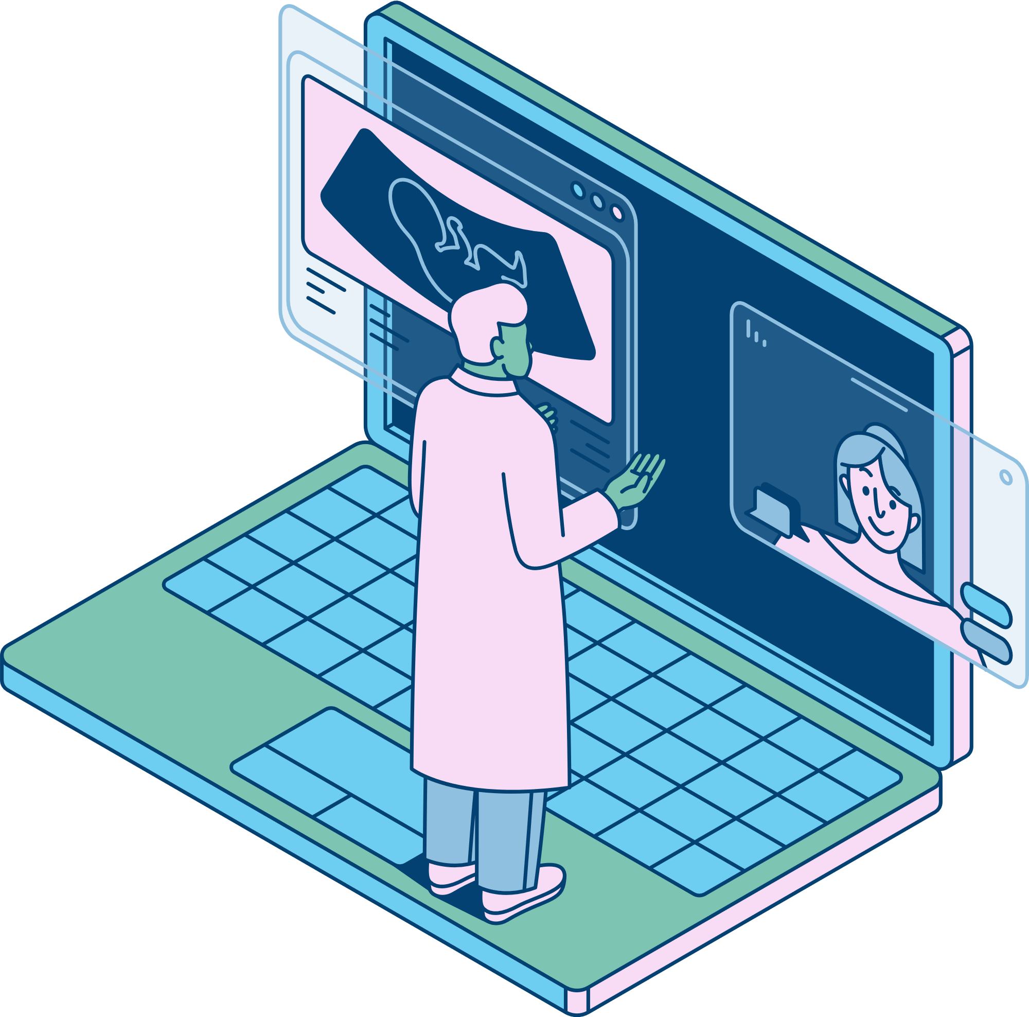
DESIGNING AND DEVELOPING
For Back-end Node.js was used for the server and MySQL for databse.
For Front-end React Native Expo go was used.

Slide 7


CHALLENGES
Developing the AI-chatbot.
Delays in the developing phase.
Providing a User freindly design.
Quality Assurance and testing.

Slide 8

THANK YOU
Group B2
PUSL2021
Computing Group Project
Name | ID | Leader Role
Ranasinghe Ranasinghe | 10903090 | Group Leader, Testing and Maintenance Leader
Priyantha Ranasinghe | 10899343 | Programming Leader
Dodampe Nimna | 10899233 | Quality Leader
Rankira Kosgollage | 10899228 | Technical Leader
Randika Gunawardena | 10899271 | Planning Leader

